Slide 1
Weekly Presentation
Jiayu Chen
2023.8.14
Notes:
Ok, I will begin my weekly Presenation.

Slide 2
Work_1: Improve code: DataDemo/simscg.py
Simulation before codes are improved:
>python simscg.py 1 0 90 180 filename
Hr:110 rr:11 sp:167 dp:70
Changing only the noise level produces completely different signals.
>python simscg.py 1 0.1 90 180 filename
Hr:77 rr:16 sp:101 dp:72
Simulation after codes are improved:
>python simscg.py 1 0 90 180 seed filename
Producing the same signal is simply a matter of the absence or presence of the noise.
Hr:110 rr:11 sp:167 dp:70
>python simscg.py 1 0.1 90 180 seed filename
Hr:110 rr:11 sp:167 dp:70
New simscg.py is uploaded to https://github.com/A-Big-Tortoise/NRSR_Research/tree/main/Code/new_simscg.py
I hope that helps.
Notes:
My first work is to make some improvements for the simulation of the scg signal.
Prof song you once give us a file called DataDemo, we can use it to simulate scg signals.
It is a little inconvenient to use. So I make some improvements.
Before the codes are improved.
Changing only the noise level produces completely different signals. If I want to test the de-noising effect of the algorithm, I have to write codes to add the noise manually.
After the codes are improved.
Producing the same signal is simply a matter of the absence or presence of noise.
It is more convenient to check the de-noising effect of the algorithm.
The new code is uploaded to my github, I hope that helps.

Slide 3
Work_2: Get Envelope, HR Rate, Segmentation, Clustering
Clean Data
(No Noise, No RR)
Envelope
Hilbert Transform
Peaks Detection
HR Estimation
Segmentation
Heartbeat Rate
Stack
K-Shapes Clustering
Template
Notes:
My second work is to try use Hilbert transform to get envelope, use Heartbeat rate to segment signals and use K-shapes clustering to get the Template signal.

Slide 4
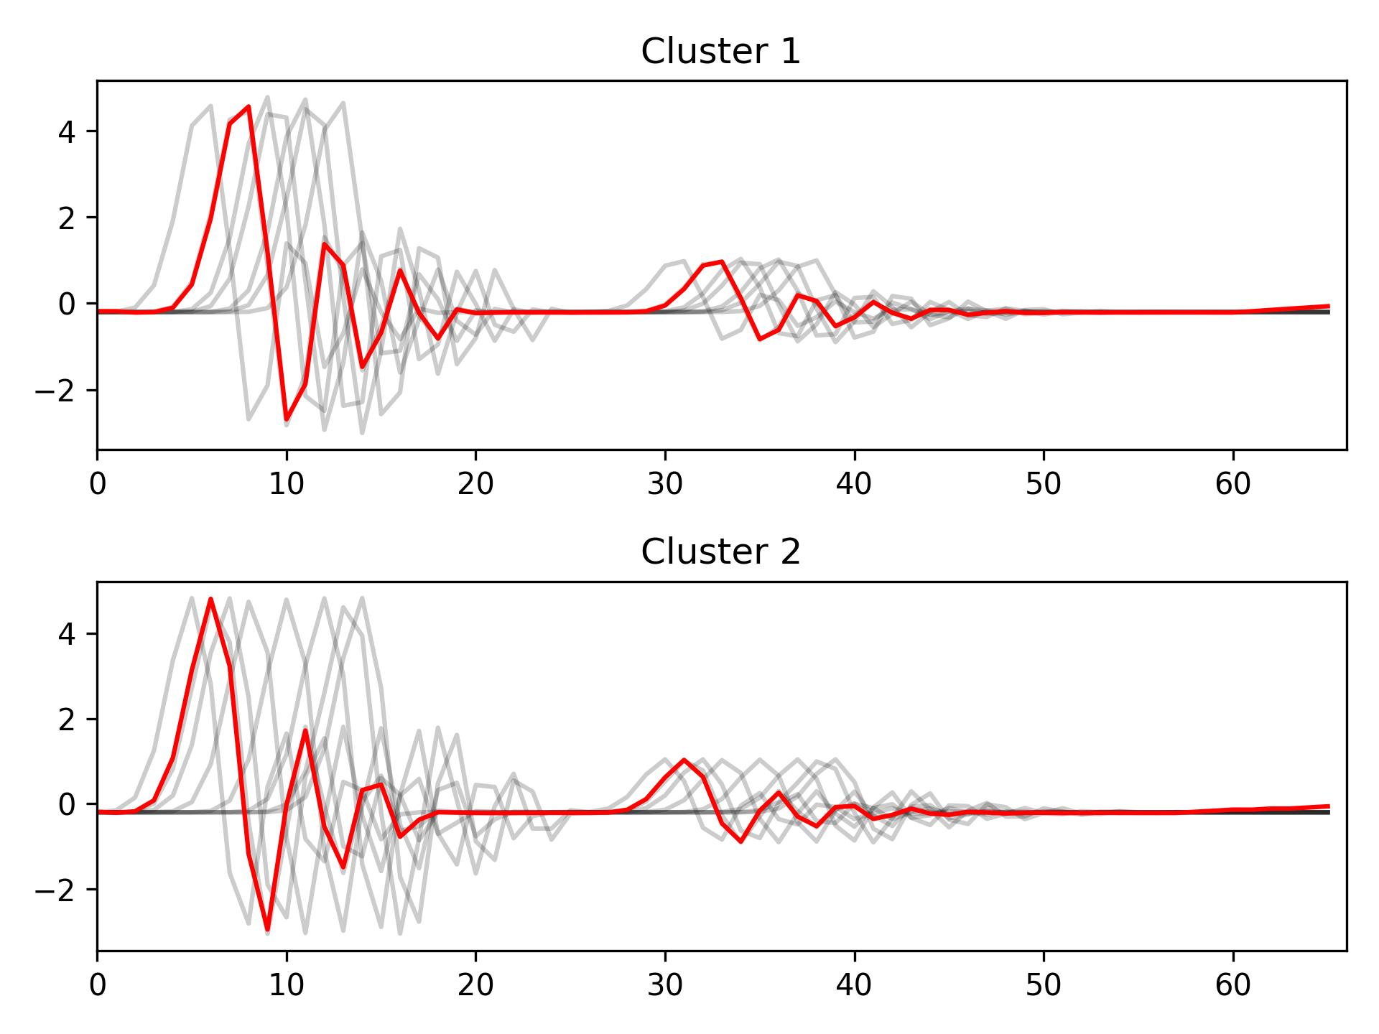
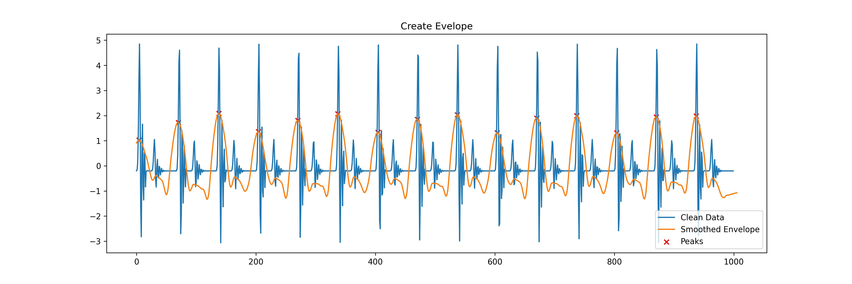
Work_2: Get Envelope, HR Rate, Segmentation, Clustering
Segmentation and Clustering
Create Envelope and Peaks Detection
After removing the noise, the envelope obtained by this method will be perfect.
Segmentation based on HR will cause each segment has different phases.
K-shapes Clustering is particularly suitable for handling this situation.
Notes:
It not hard, I just show the result.
The fist picture is about create envelope and peak detection.
We can see.
After removing the noise, the envelope obtained by this method will be perfect.
The 2nd picture is about Segmentation and clustering
Segmentation based on HR will cause each segment has different phases.
K-shapes Clustering is particularly suitable for handling this situation.
If noise Are Removed, this pipeline will work well.

Slide 5
Work_3: Implement One Paper: Band Filter, EEMD, PCA and Spectrum Analysis
Clean Data / Noisy Data
Band-pass Filter
EEMD / EMD
PCA
Spectrum Analysis
RR & HR Estimation

Slide 6
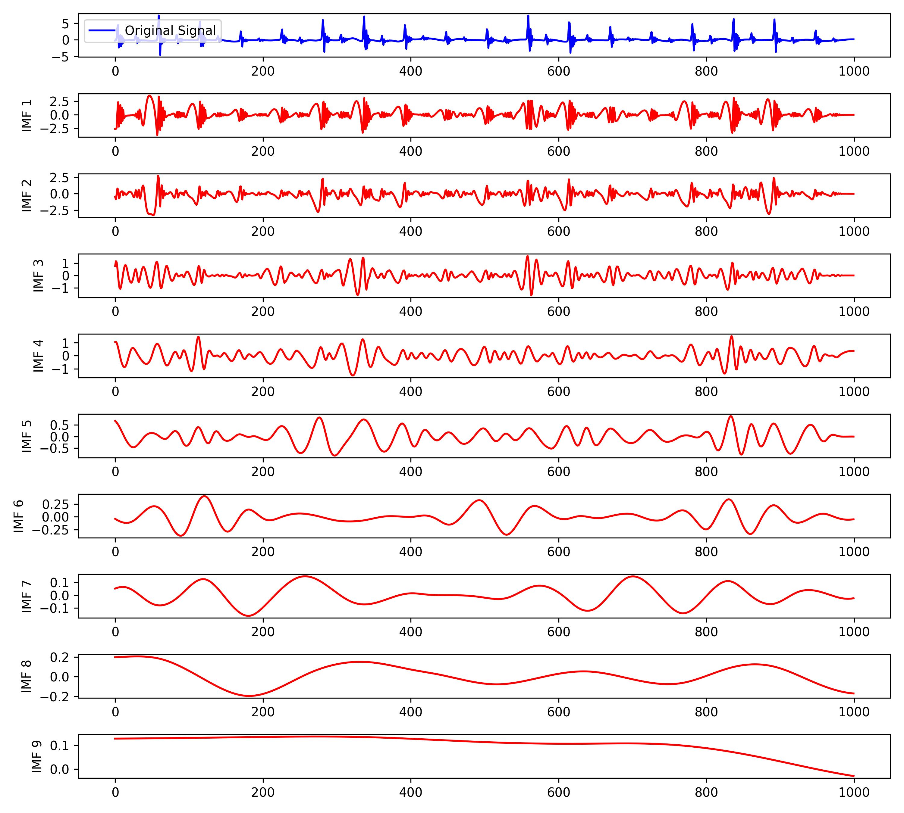
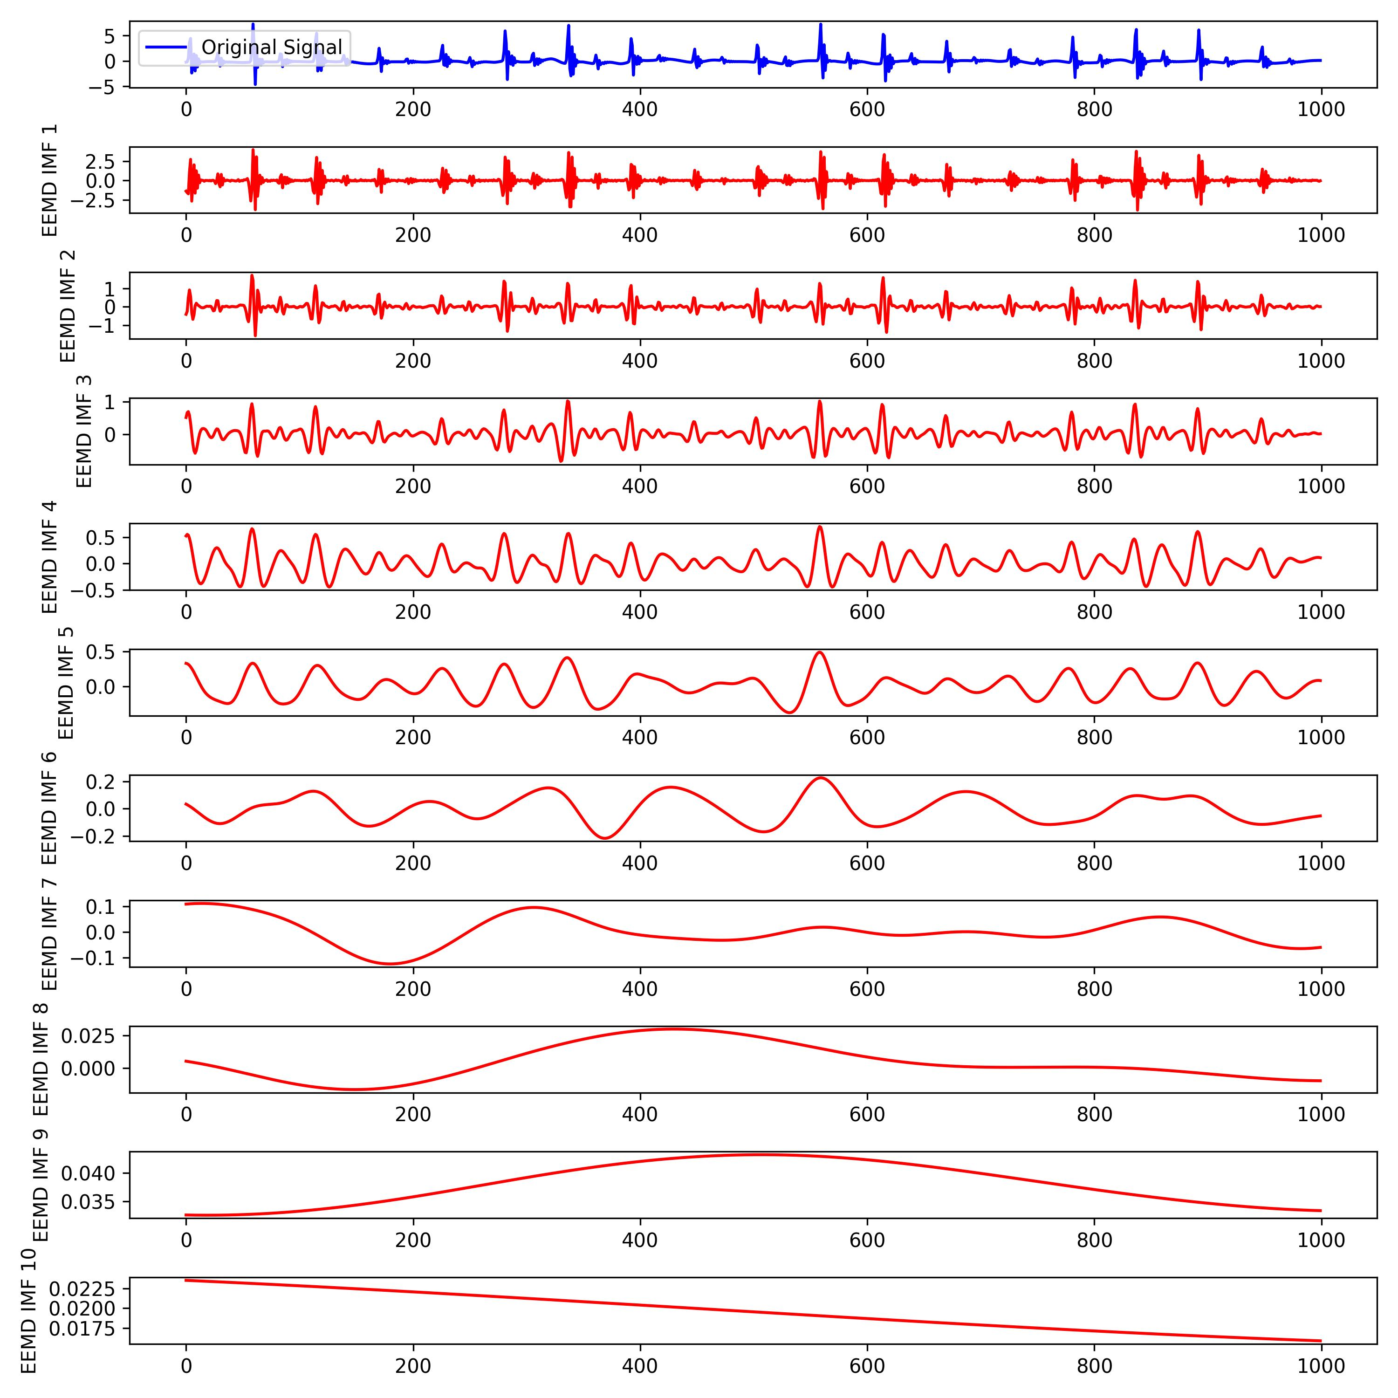
Work_3: Implement One Paper: Band Filter, EEMD, PCA and Spectrum Analysis
Band-pass filter:
EMD and EEMD:
EMD
EEMD
从IMF_1 and IMF_2来看, EEMD 的分解效果更加好，选择EEMD

Slide 7
Work_3: Implement One Paper: Band Filter, EEMD, PCA and Spectrum Analysis
IMFs的挑选:
IMFs的融合:
策略1:PCA
0.75 Hz < IMFs < 2.25 Hz
Group1: HR Estimation
策略2: 当被选择出来的IMF仅有一个时，不在使用PCA，直接使用IMF
0.1 Hz < IMFs < 0.75 Hz
Group2: RR Estimation
策略3:不使用PCA，直接将IMFs相加

Slide 8
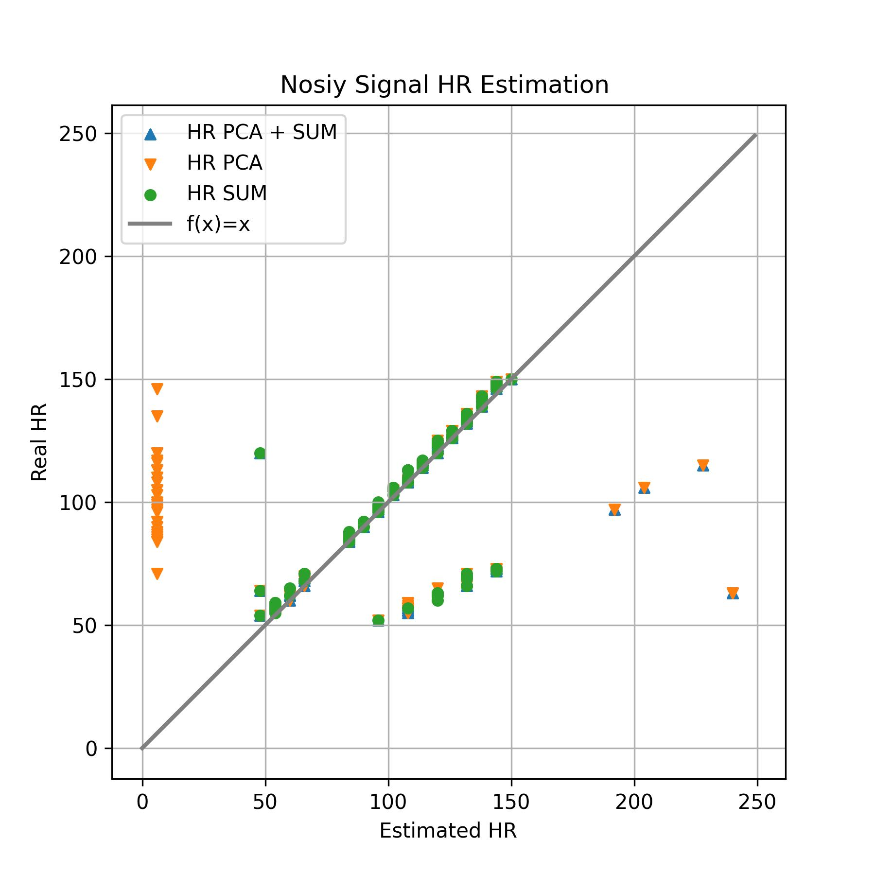
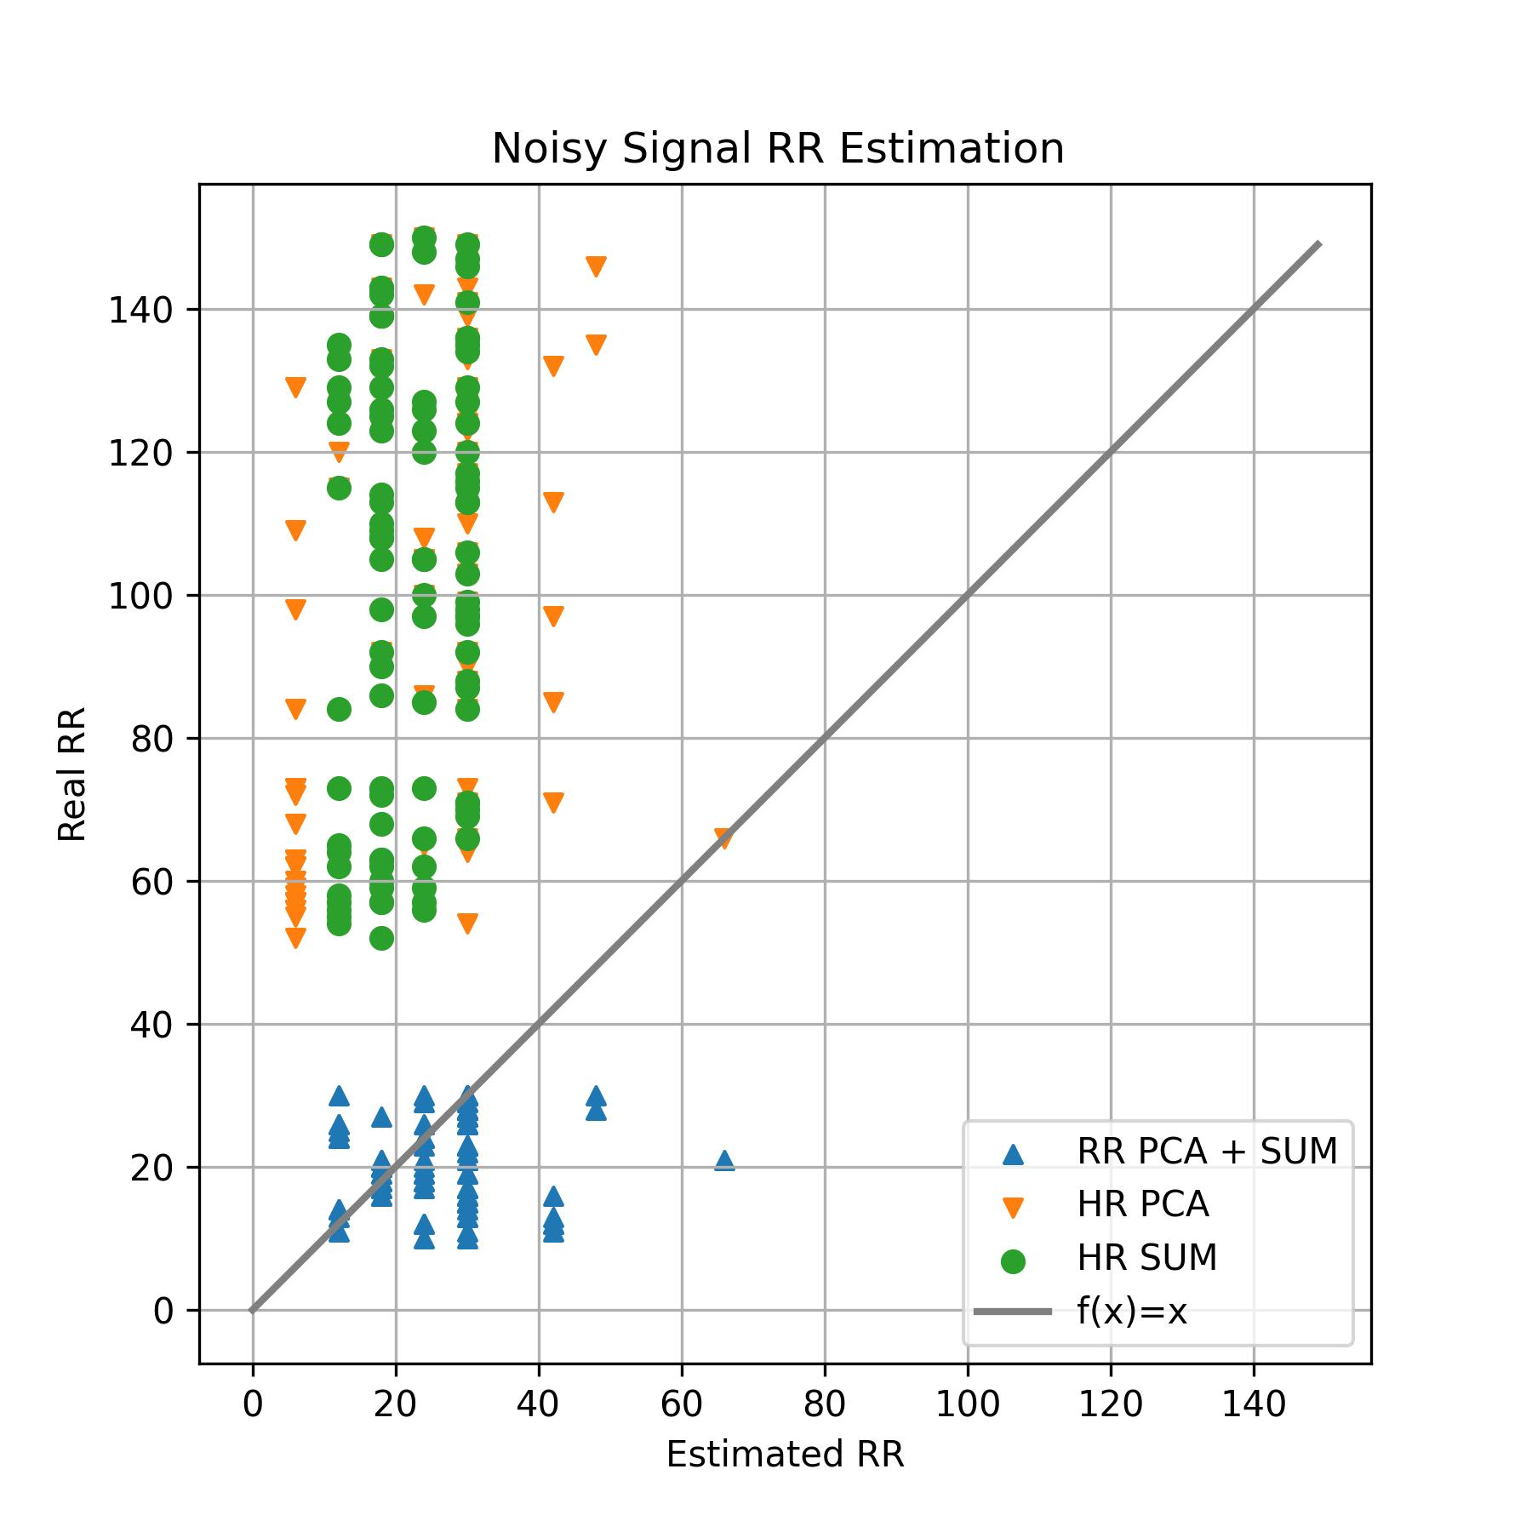
Work_3: Implement One Paper: Band Filter, EEMD, PCA and Spectrum Analysis
Conclusion:
HR Estimation 中，直接求和的策略会比较好，带有PCA的策略会有较多的离群点
RR Estimation 中，效果都很差。原因在于信号没有做降噪处理。
HR ranging from
[50, 150]
RR ranging from
[10, 30]

Slide 9
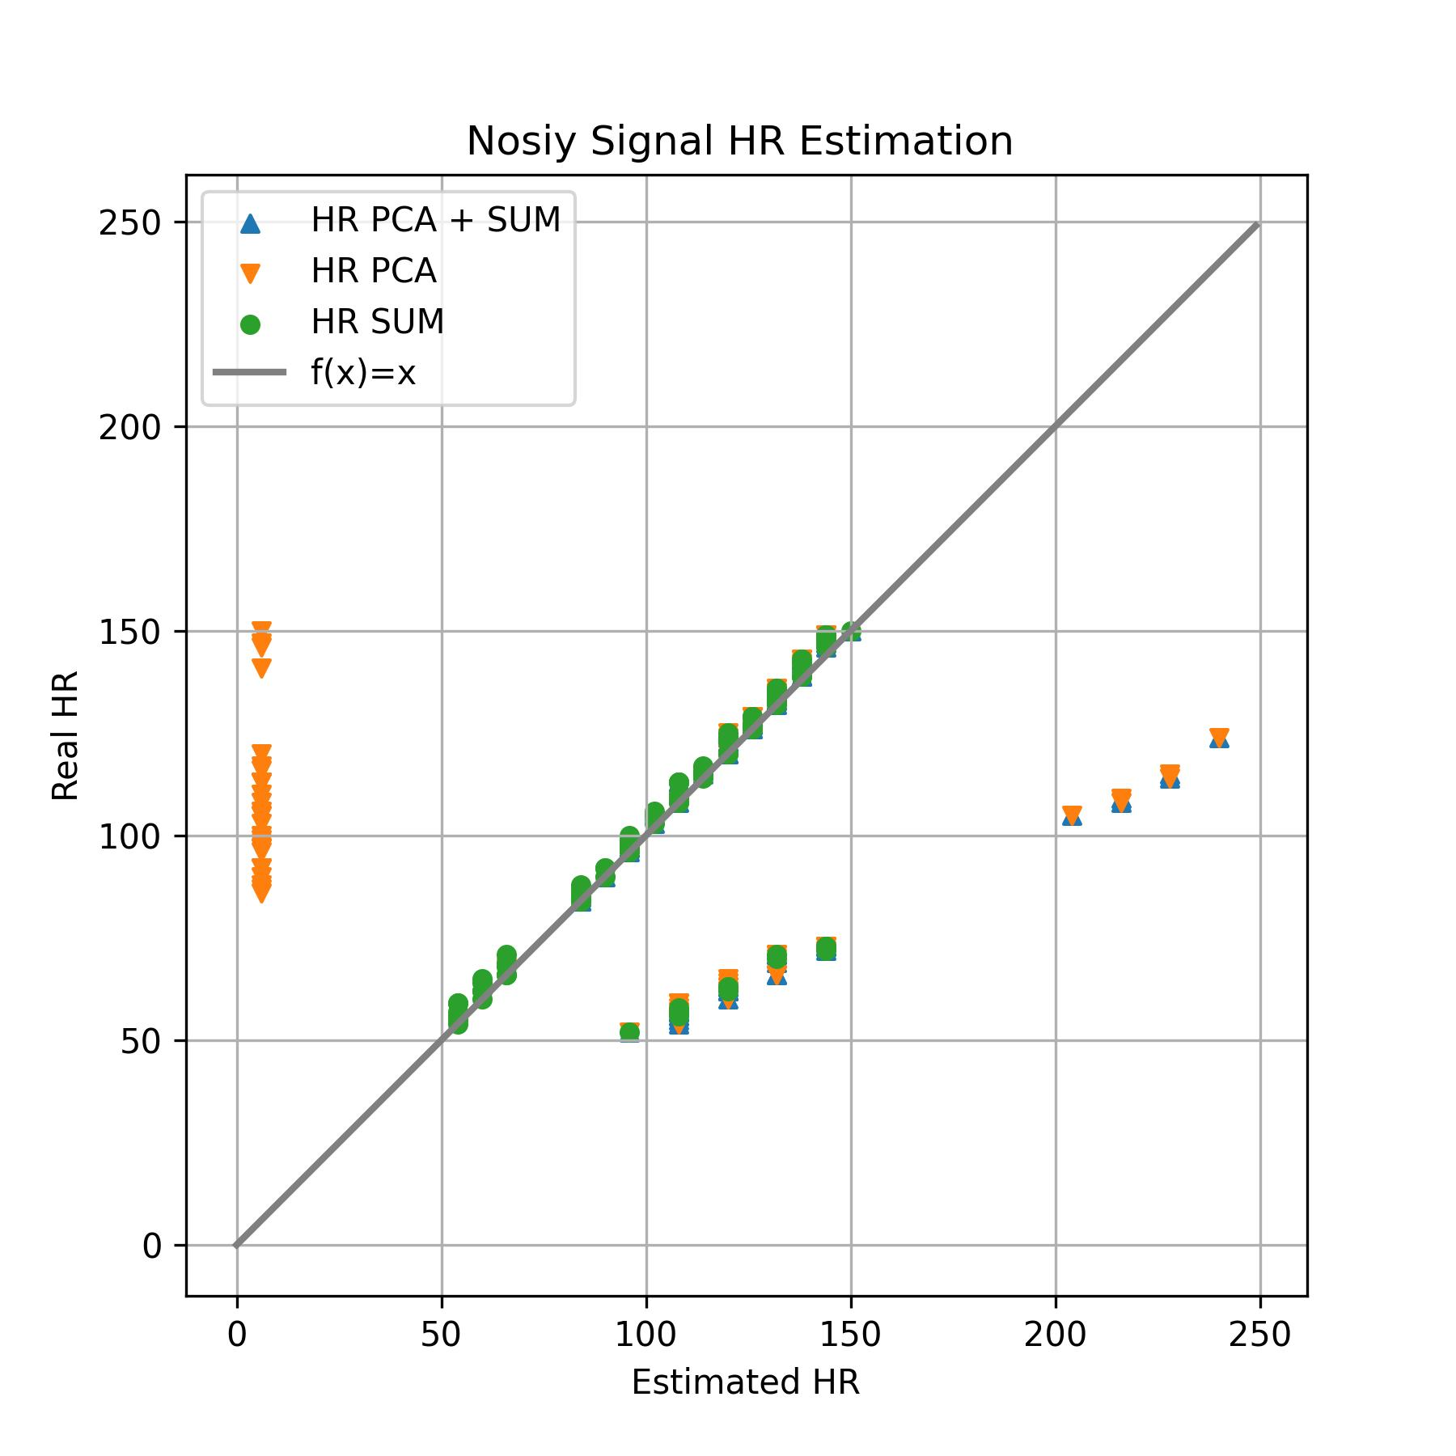
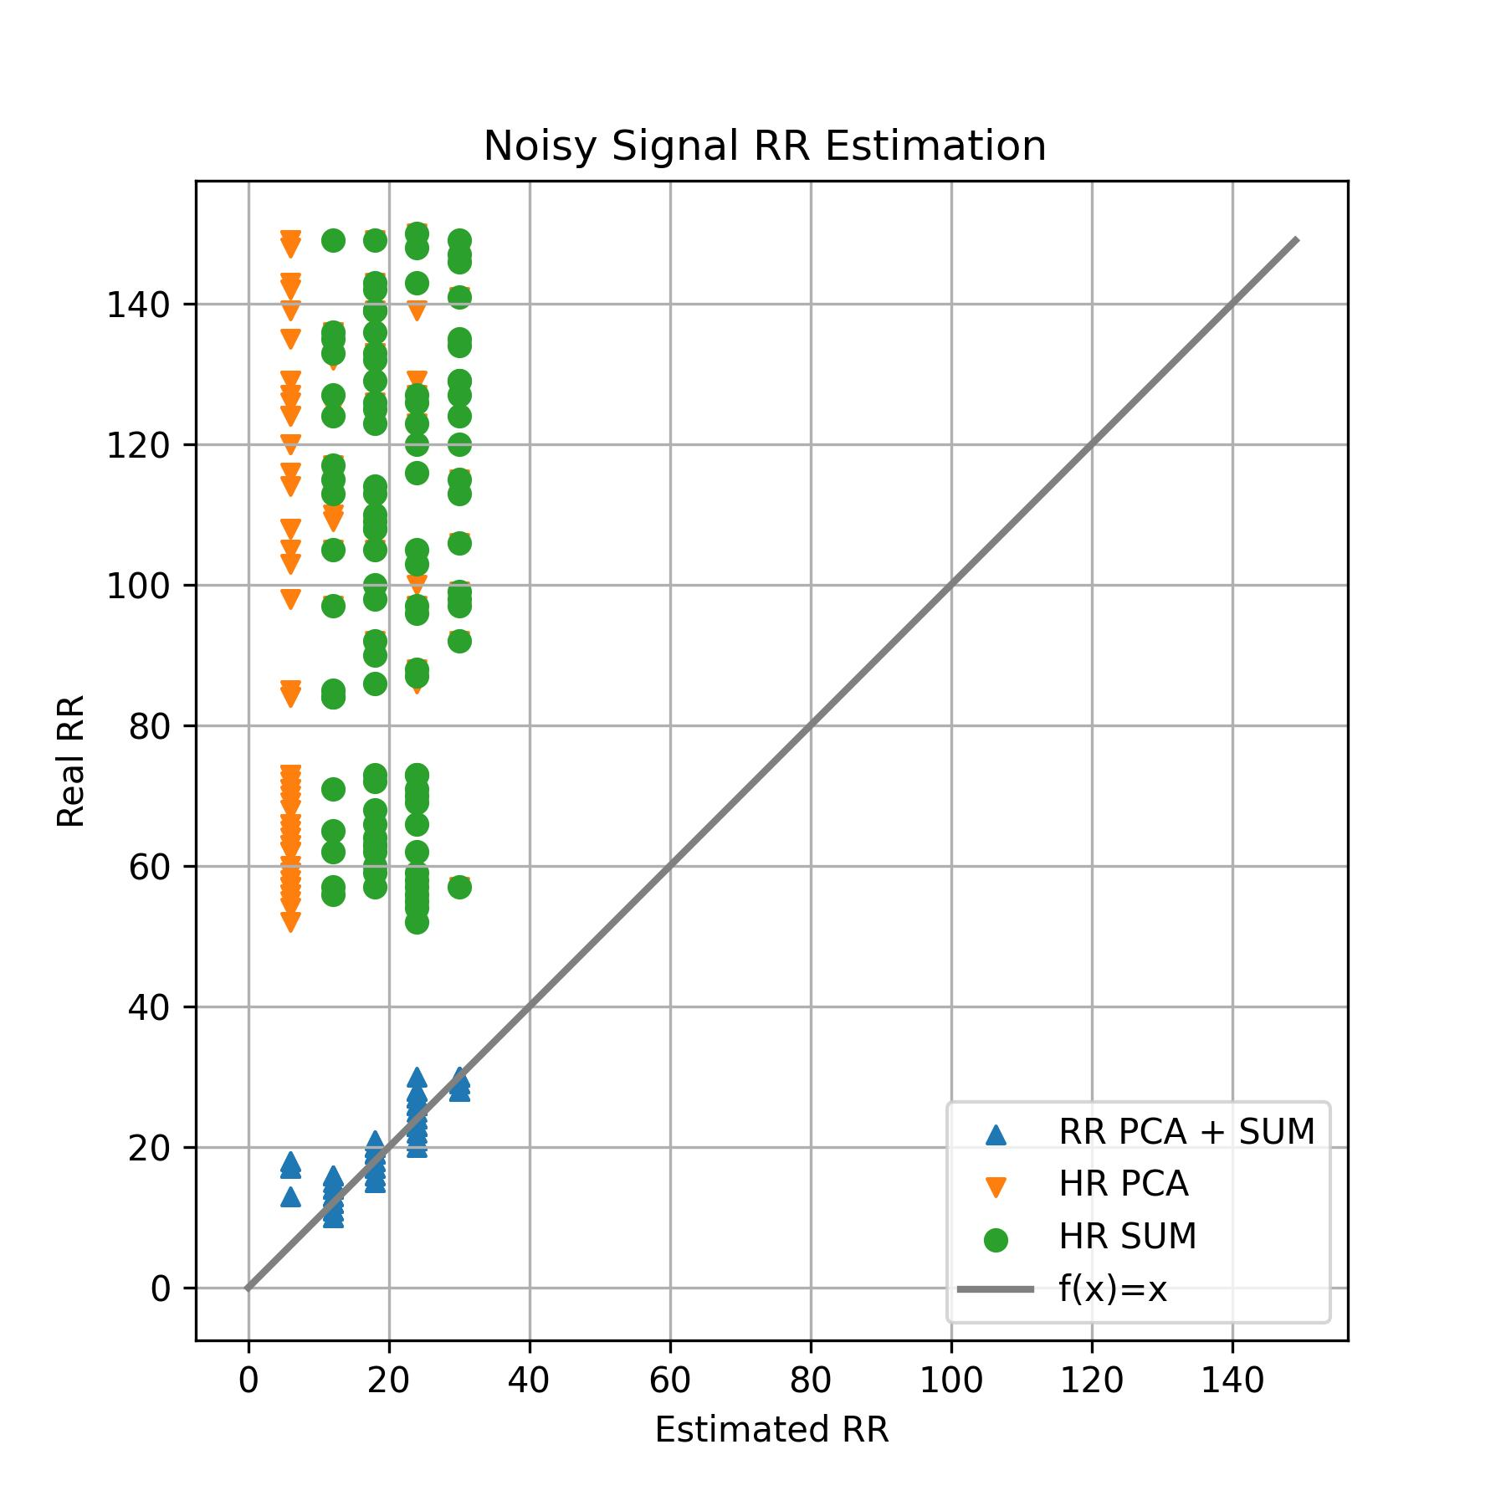
Work_3: Implement One Paper: Band Filter, EEMD, PCA and Spectrum Analysis
Clean Signal HR Estimation
Clean Signal RR Estimation
Conclusion:
降噪以后HR,RR Estimation的效果都显著提升
HREstimation中，对IMFS求和的策略效果最好
RR Estimation中，PCA+SUM的效果最好
HR ranging from
[50, 150]
RR ranging from
[10, 30]
不能完全达到论文中精度的两个原因：
原论文中使用的ECG信号
IMFs的挑选这一步，可能与原论文中的实现方法不一致

Slide 10
Work_4: Clustering Exploration
2个想法：
对原始信号的片段直接聚类，他们的某些指标会不会也随之聚类。
能否通过对原始信号的片段直接聚类，帮助我们提升HR，RR估计的精度？
我对原始信号直接聚类，得出了5个结论。
Notes:
2个想法：
对原始信号的片段直接聚类，他们的某些指标会不会也随之聚类。
能否通过对原始信号的片段聚类，帮助我们提升某些指标估计的精度？
所以，我对此展开了实验，得出了5个结论

Slide 11
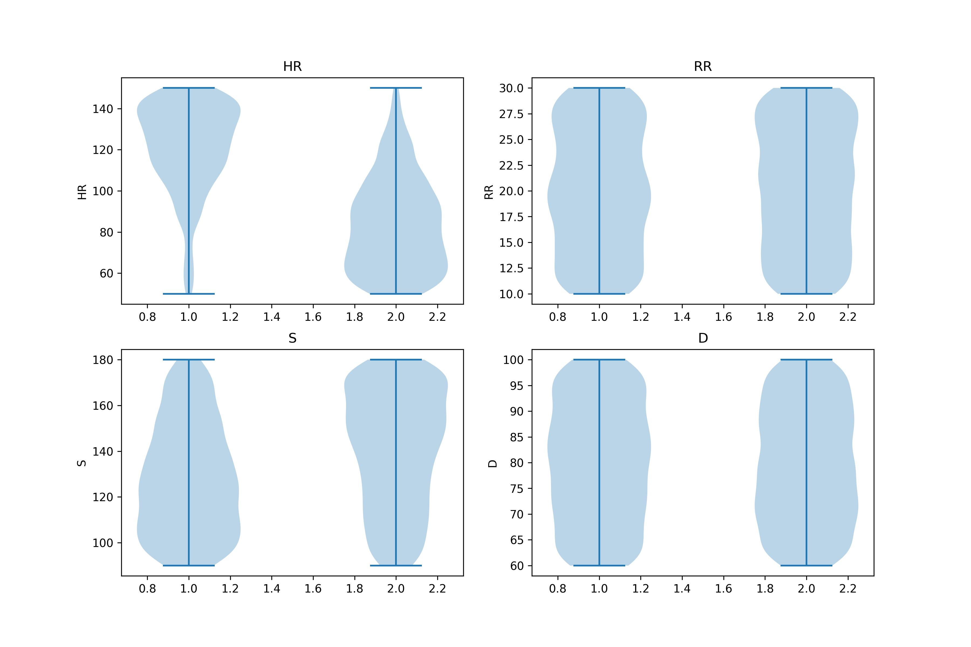
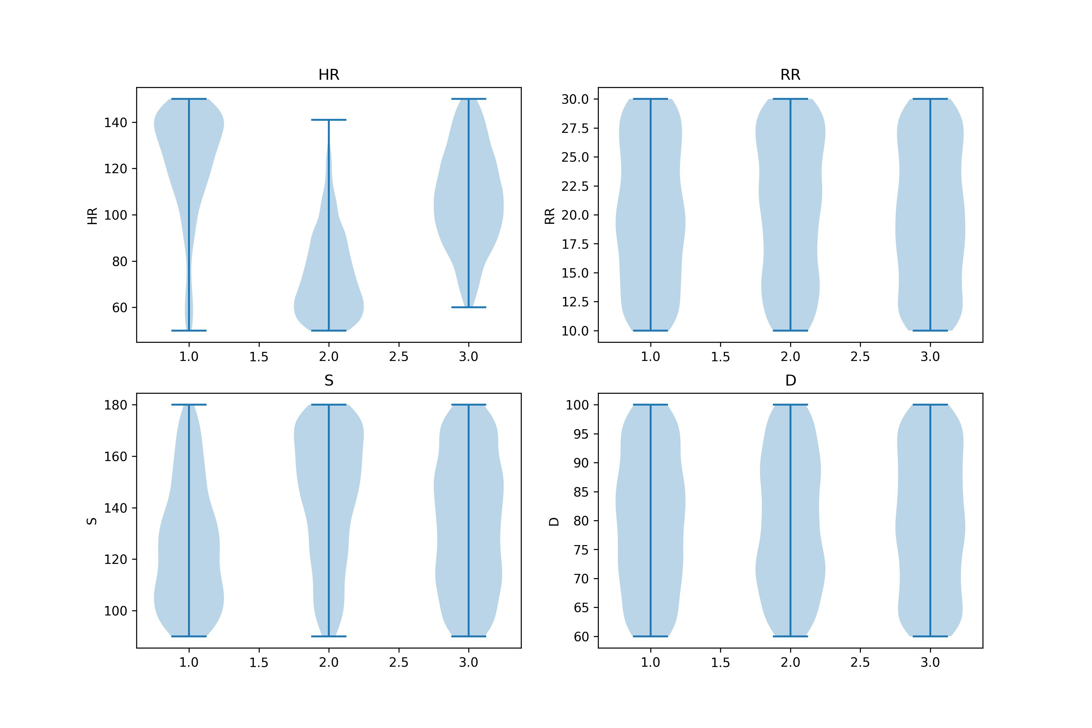
Work_4: Clustering Exploration
Conclusion 1:对HR有较为明显的分类作用， 对S有轻微的分类，对其余两个指标完全没意义
Notes:
2个想法：
对原始信号的片段直接聚类，他们的某些指标会不会也随之聚类。
能否通过对原始信号的片段聚类，帮助我们提升某些指标估计的精度？
所以，我对此展开了实验，得出了5个结论

Slide 12
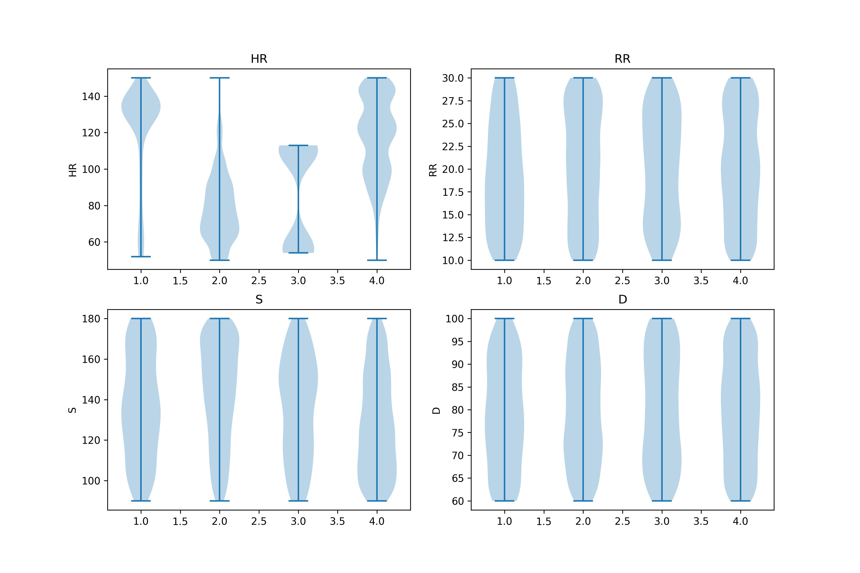
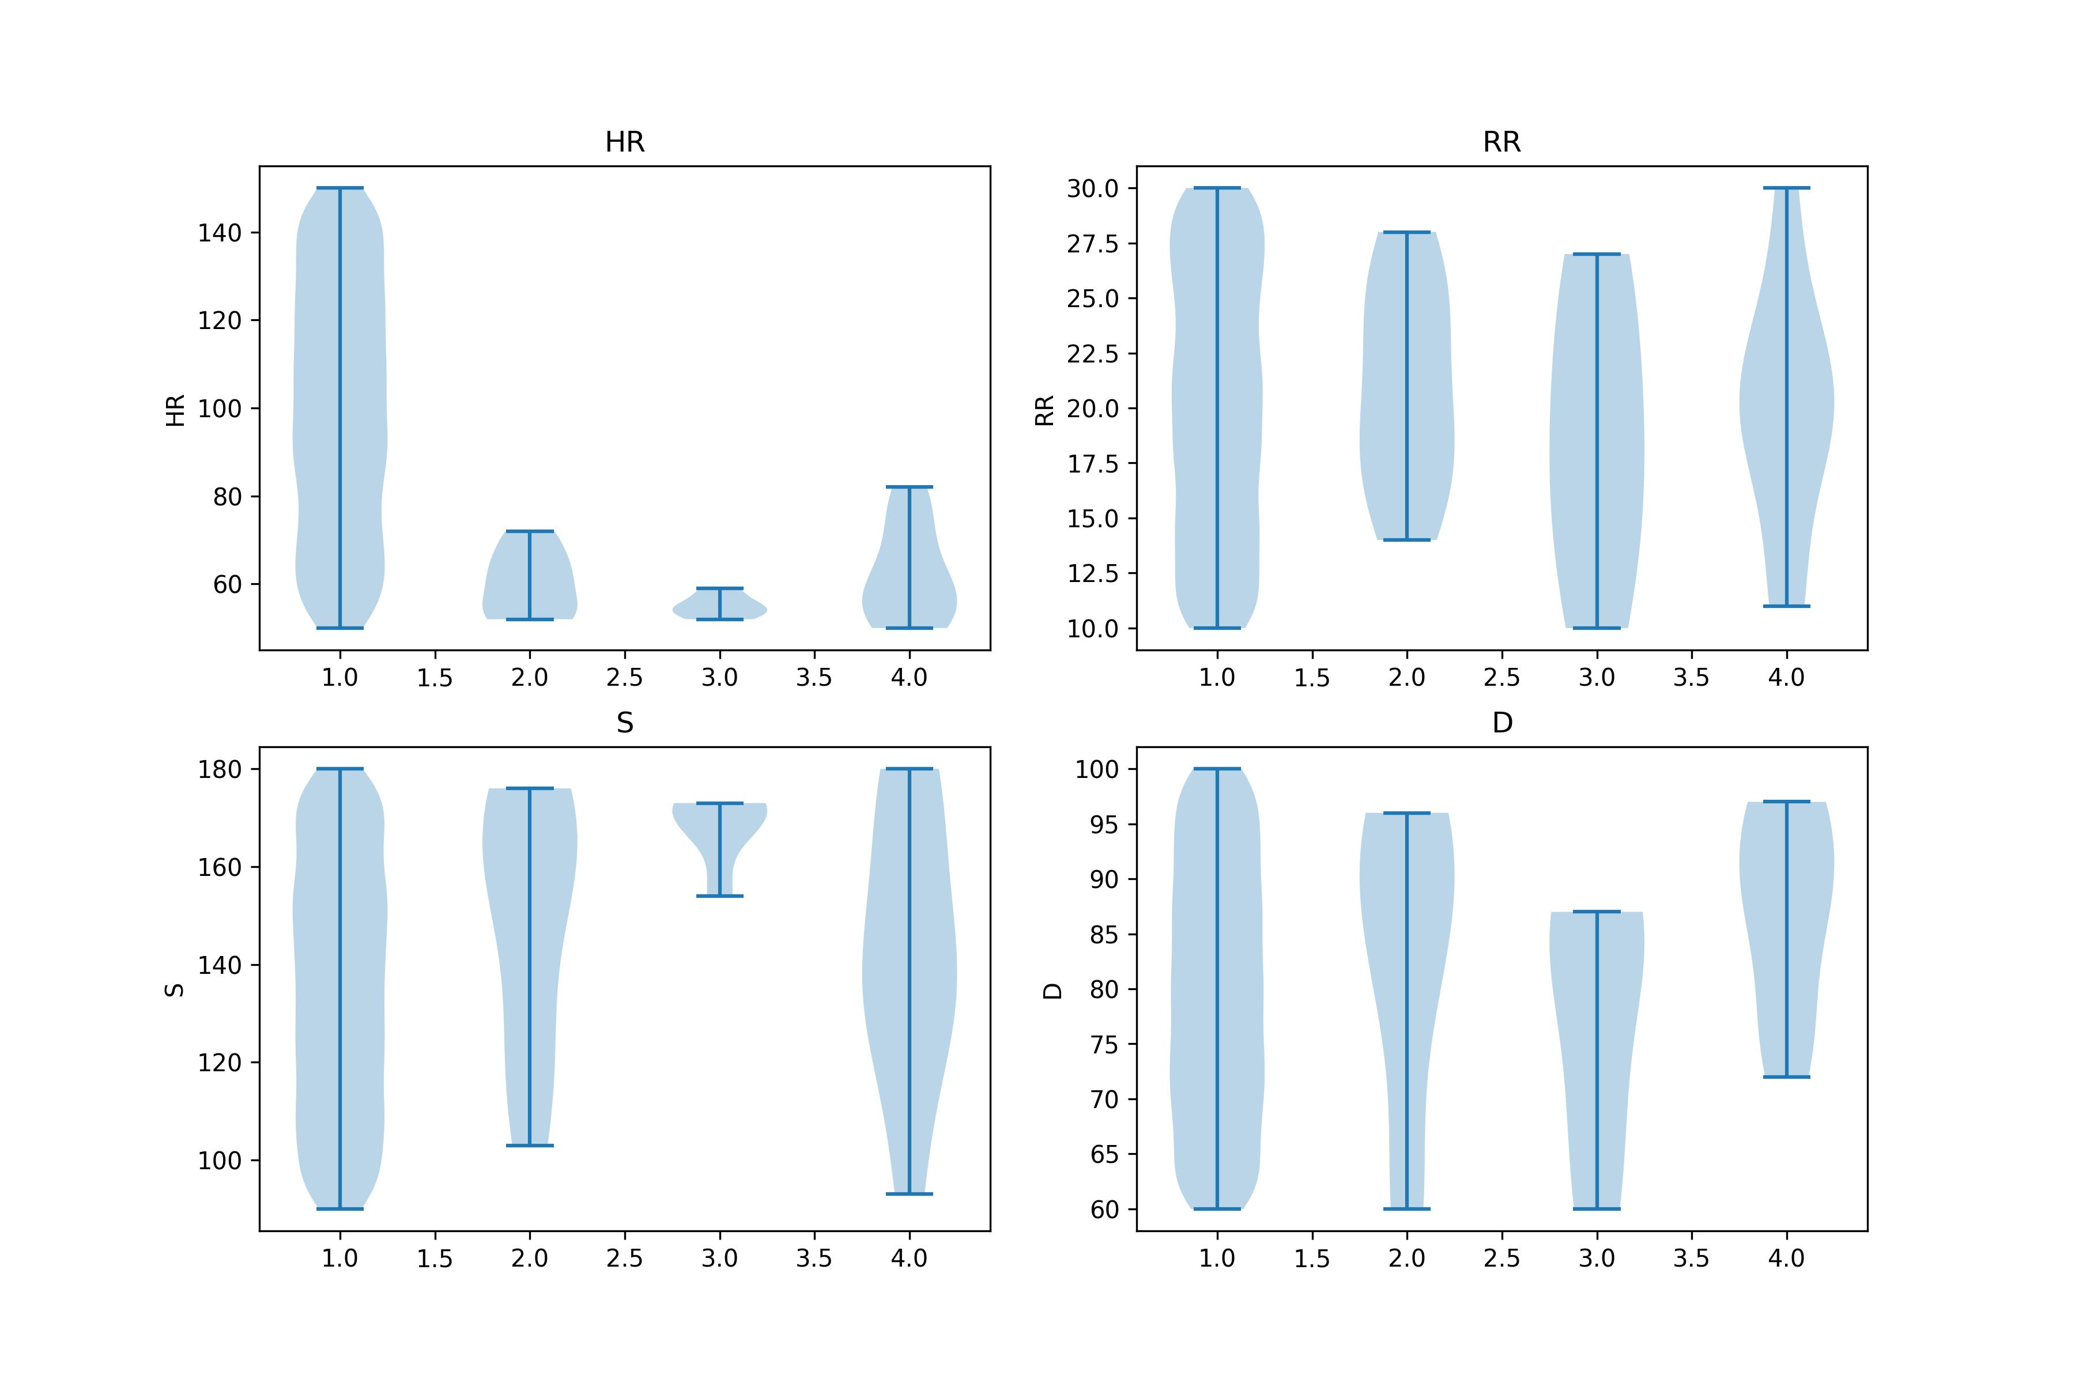
Work_4: Clustering Exploration
Conclusion 2: 聚类>3时，没有意义
K-Shapes, Noisy signals
K-Means, Noisy signals
Notes:
2个想法：
对原始信号的片段直接聚类，他们的某些指标会不会也随之聚类。
能否通过对原始信号的片段聚类，帮助我们提升某些指标估计的精度？
所以，我对此展开了实验，得出了5个结论

Slide 13
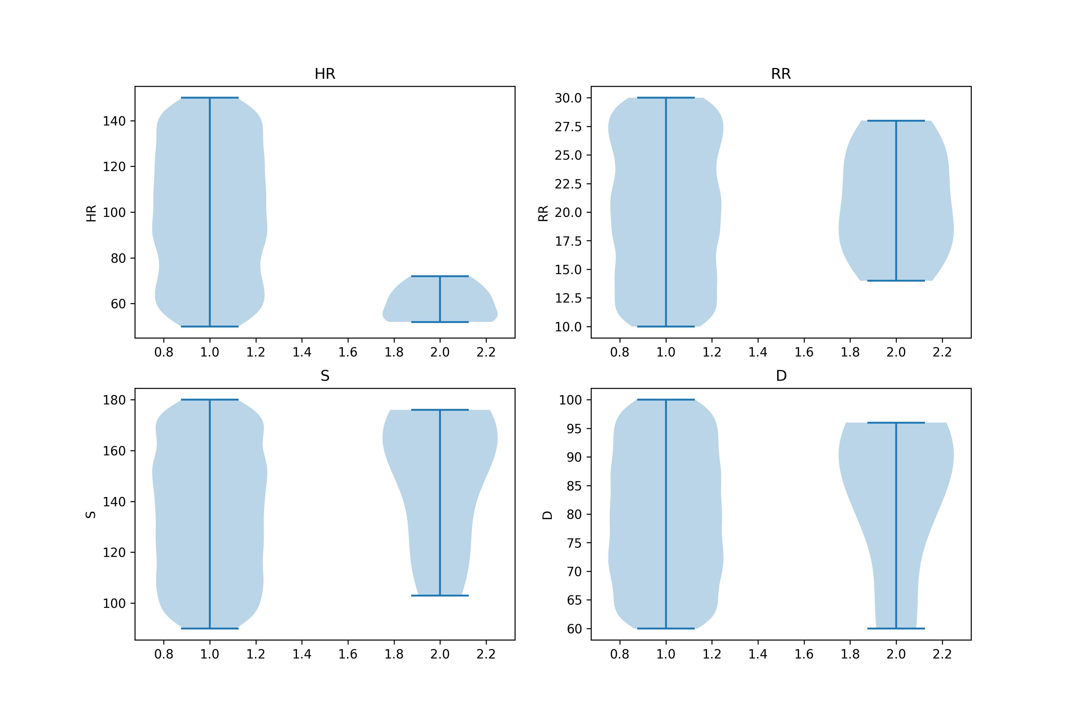
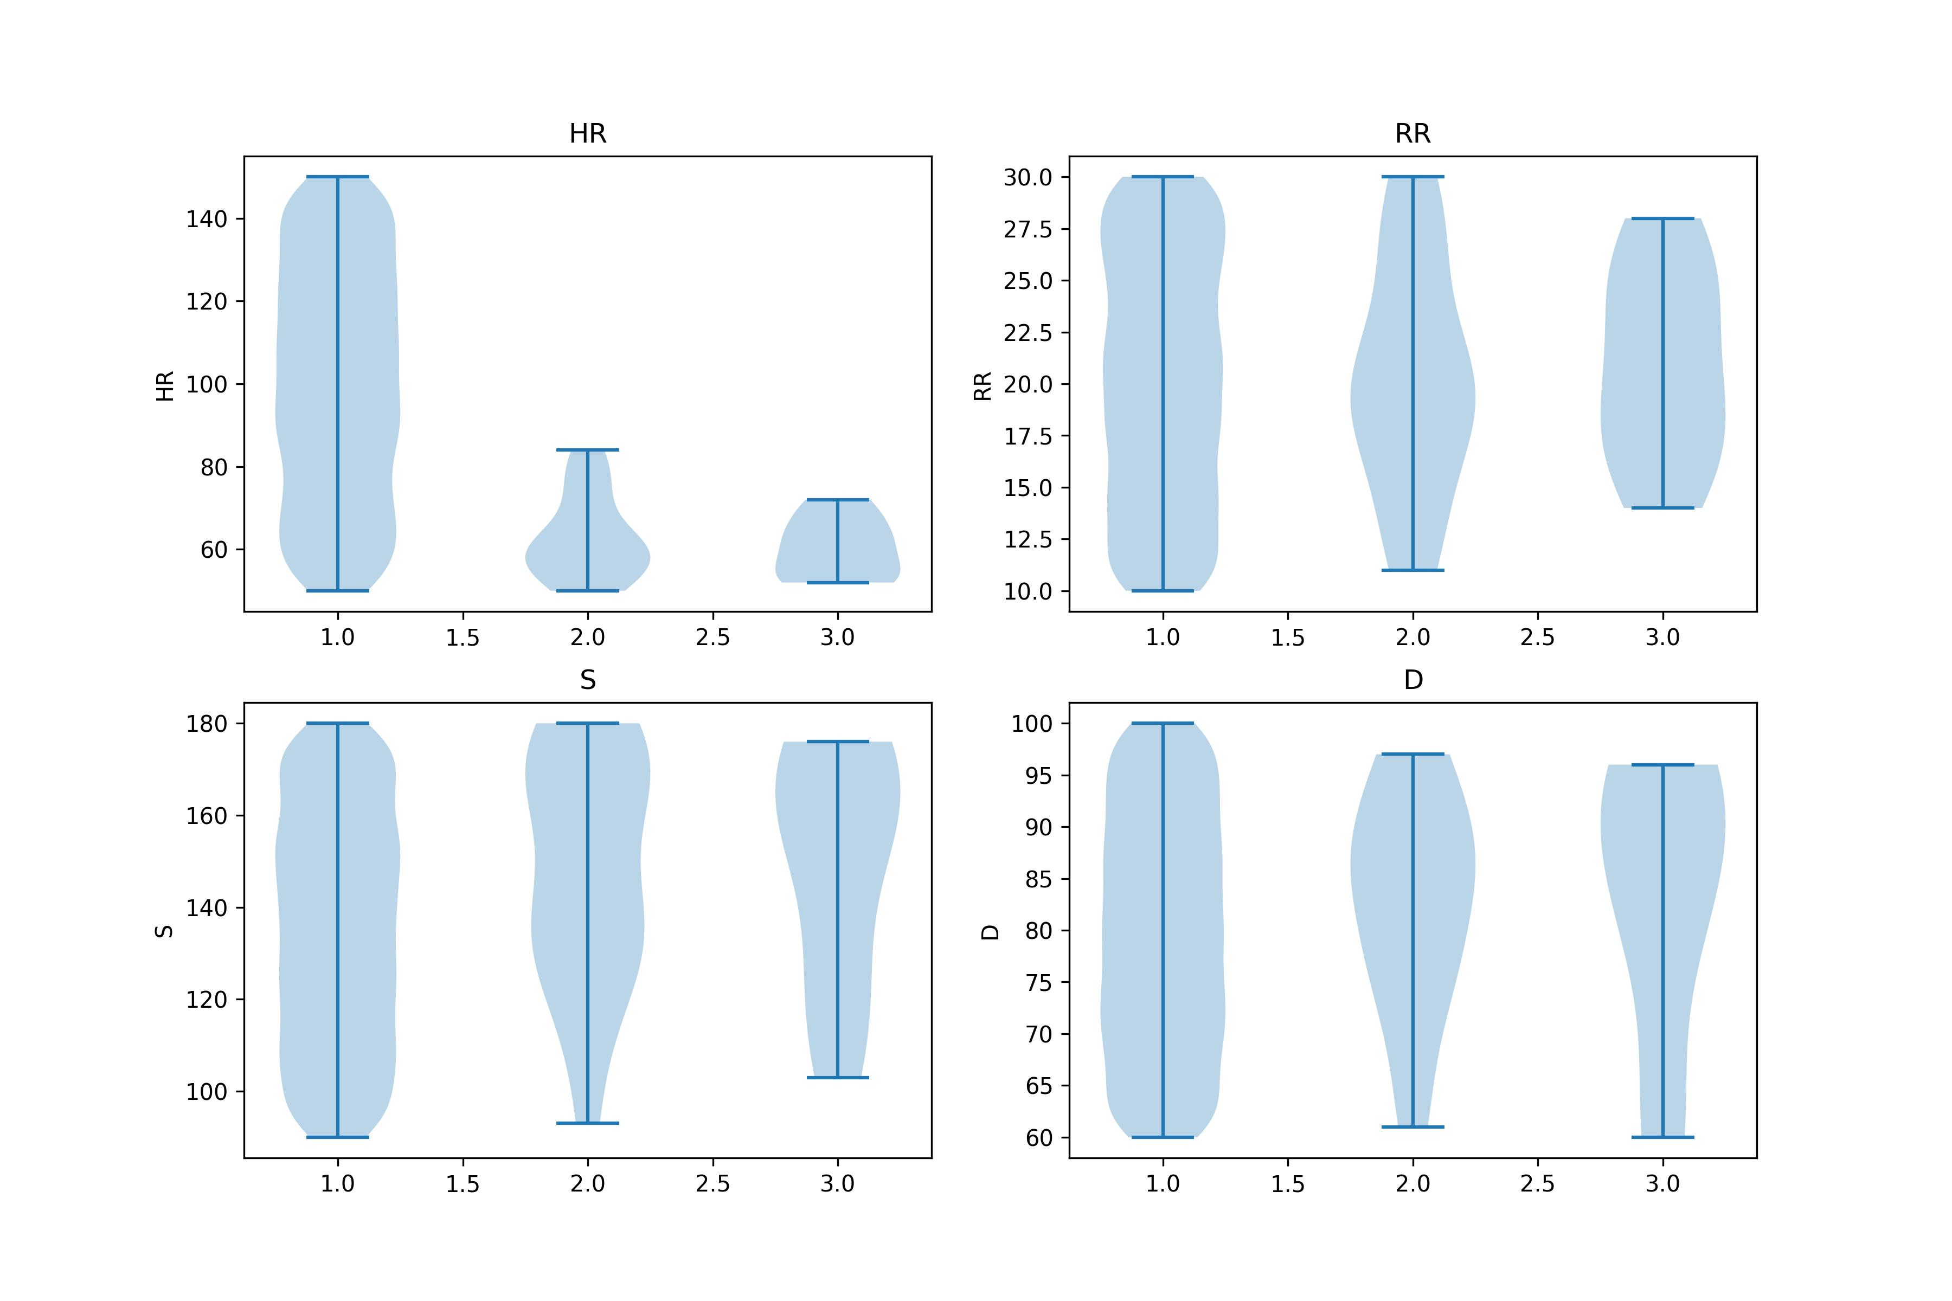
Work_4: Clustering Exploration
Conclusion 3: K-shapes >> K-Means
K-Shapes, Noisy signals
K-Means, Noisy signals
K-Shapes, Noisy signals
K-Means, Noisy signals

Slide 14
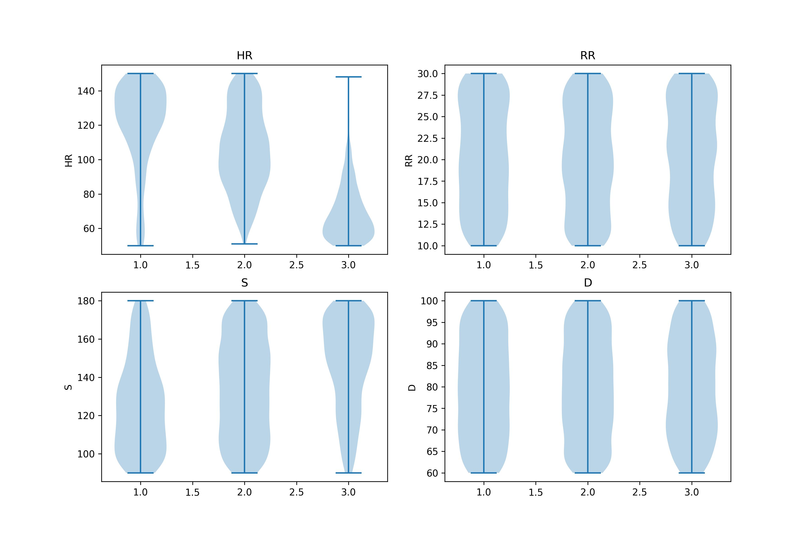
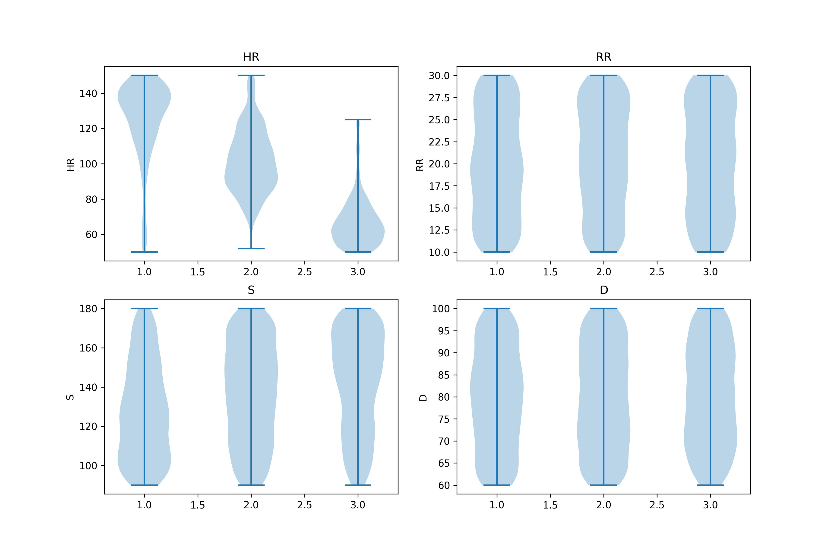
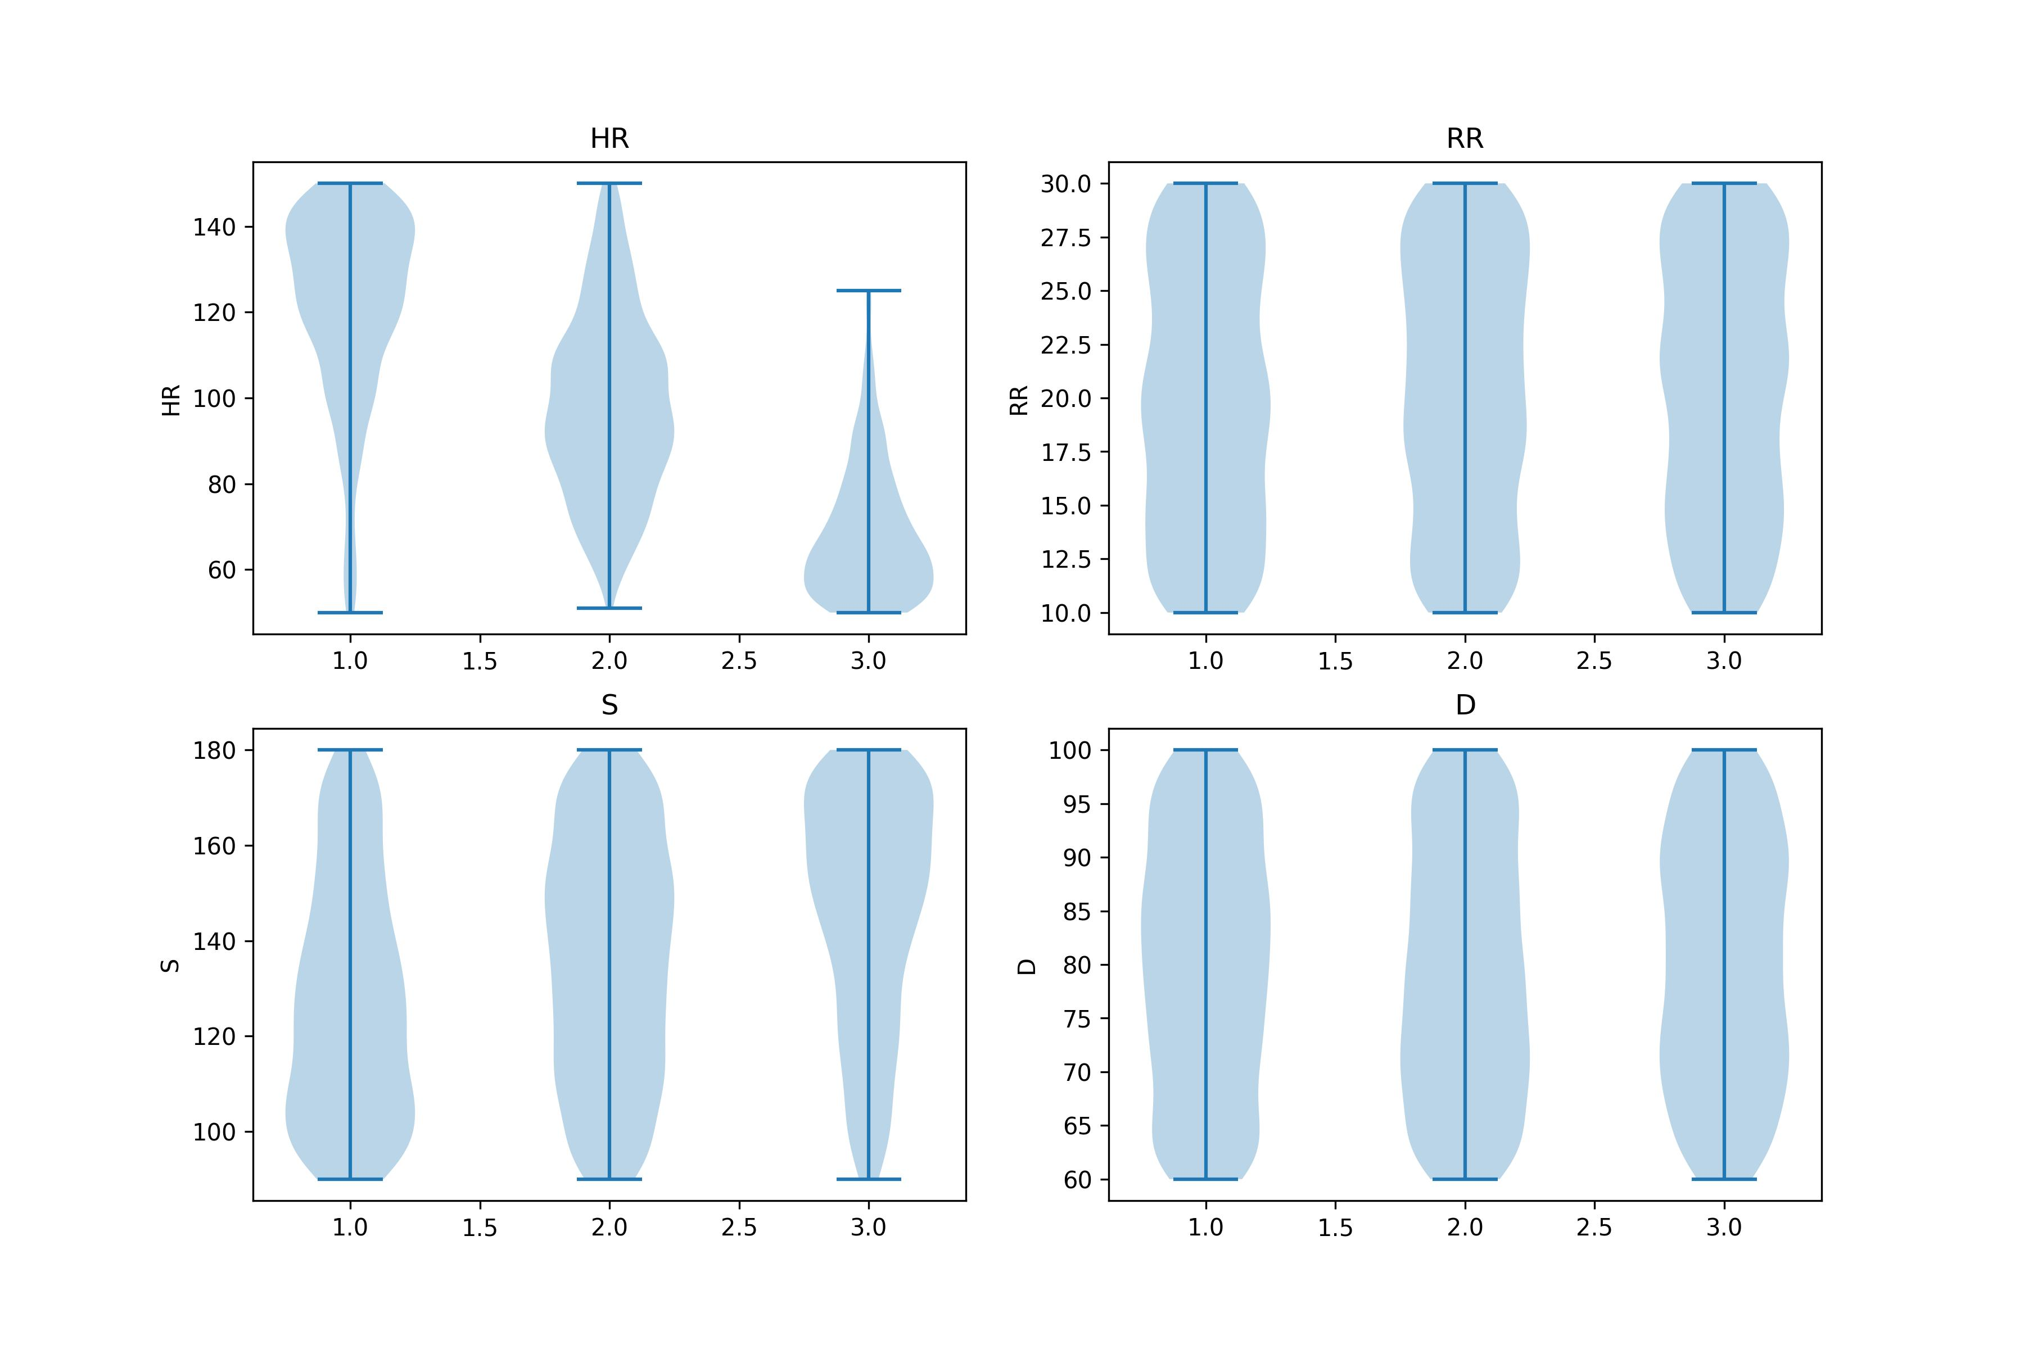
Work_4: Clustering Exploration
Conclusion 4: 对截取信号的长度不是很敏感，但不宜过长和过短。
K-Shapes, 300ms
K-Shapes, 600ms
K-Shapes, 1200ms
K-Shapes, 2400ms
所截取信号片段长度与HR指标的聚类效果（主观）
效果
0.3
0.6
1.2
2.4
Second
Notes:
2个想法：
对原始信号的片段直接聚类，他们的某些指标会不会也随之聚类。
能否通过对原始信号的片段聚类，帮助我们提升某些指标估计的精度？
所以，我对此展开了实验，得出了5个结论

Slide 15
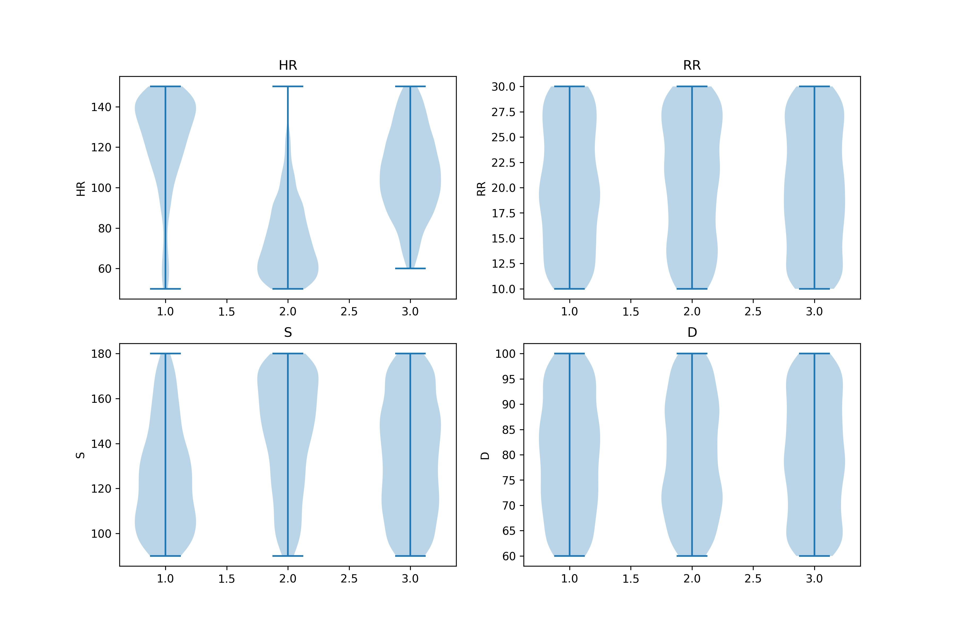
Work_4: Clustering Exploration
Conclusion 5: 对噪声不是很敏感
K-Shapes，120ms
I checked codes several times, the clustering results is the same, 不管是不是有这0.1dB nosie
Noisy
No Noise
Noisy
No Noise
Notes:
2个想法：
对原始信号的片段直接聚类，他们的某些指标会不会也随之聚类。
能否通过对原始信号的片段聚类，帮助我们提升某些指标估计的精度？
所以，我对此展开了实验，得出了5个结论

Slide 16
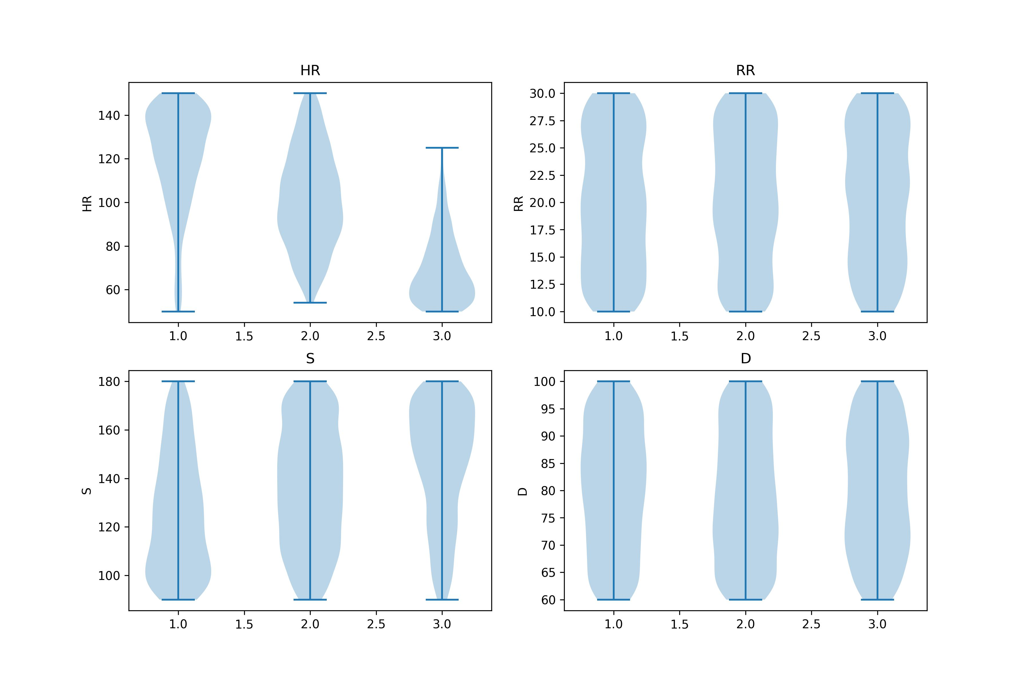
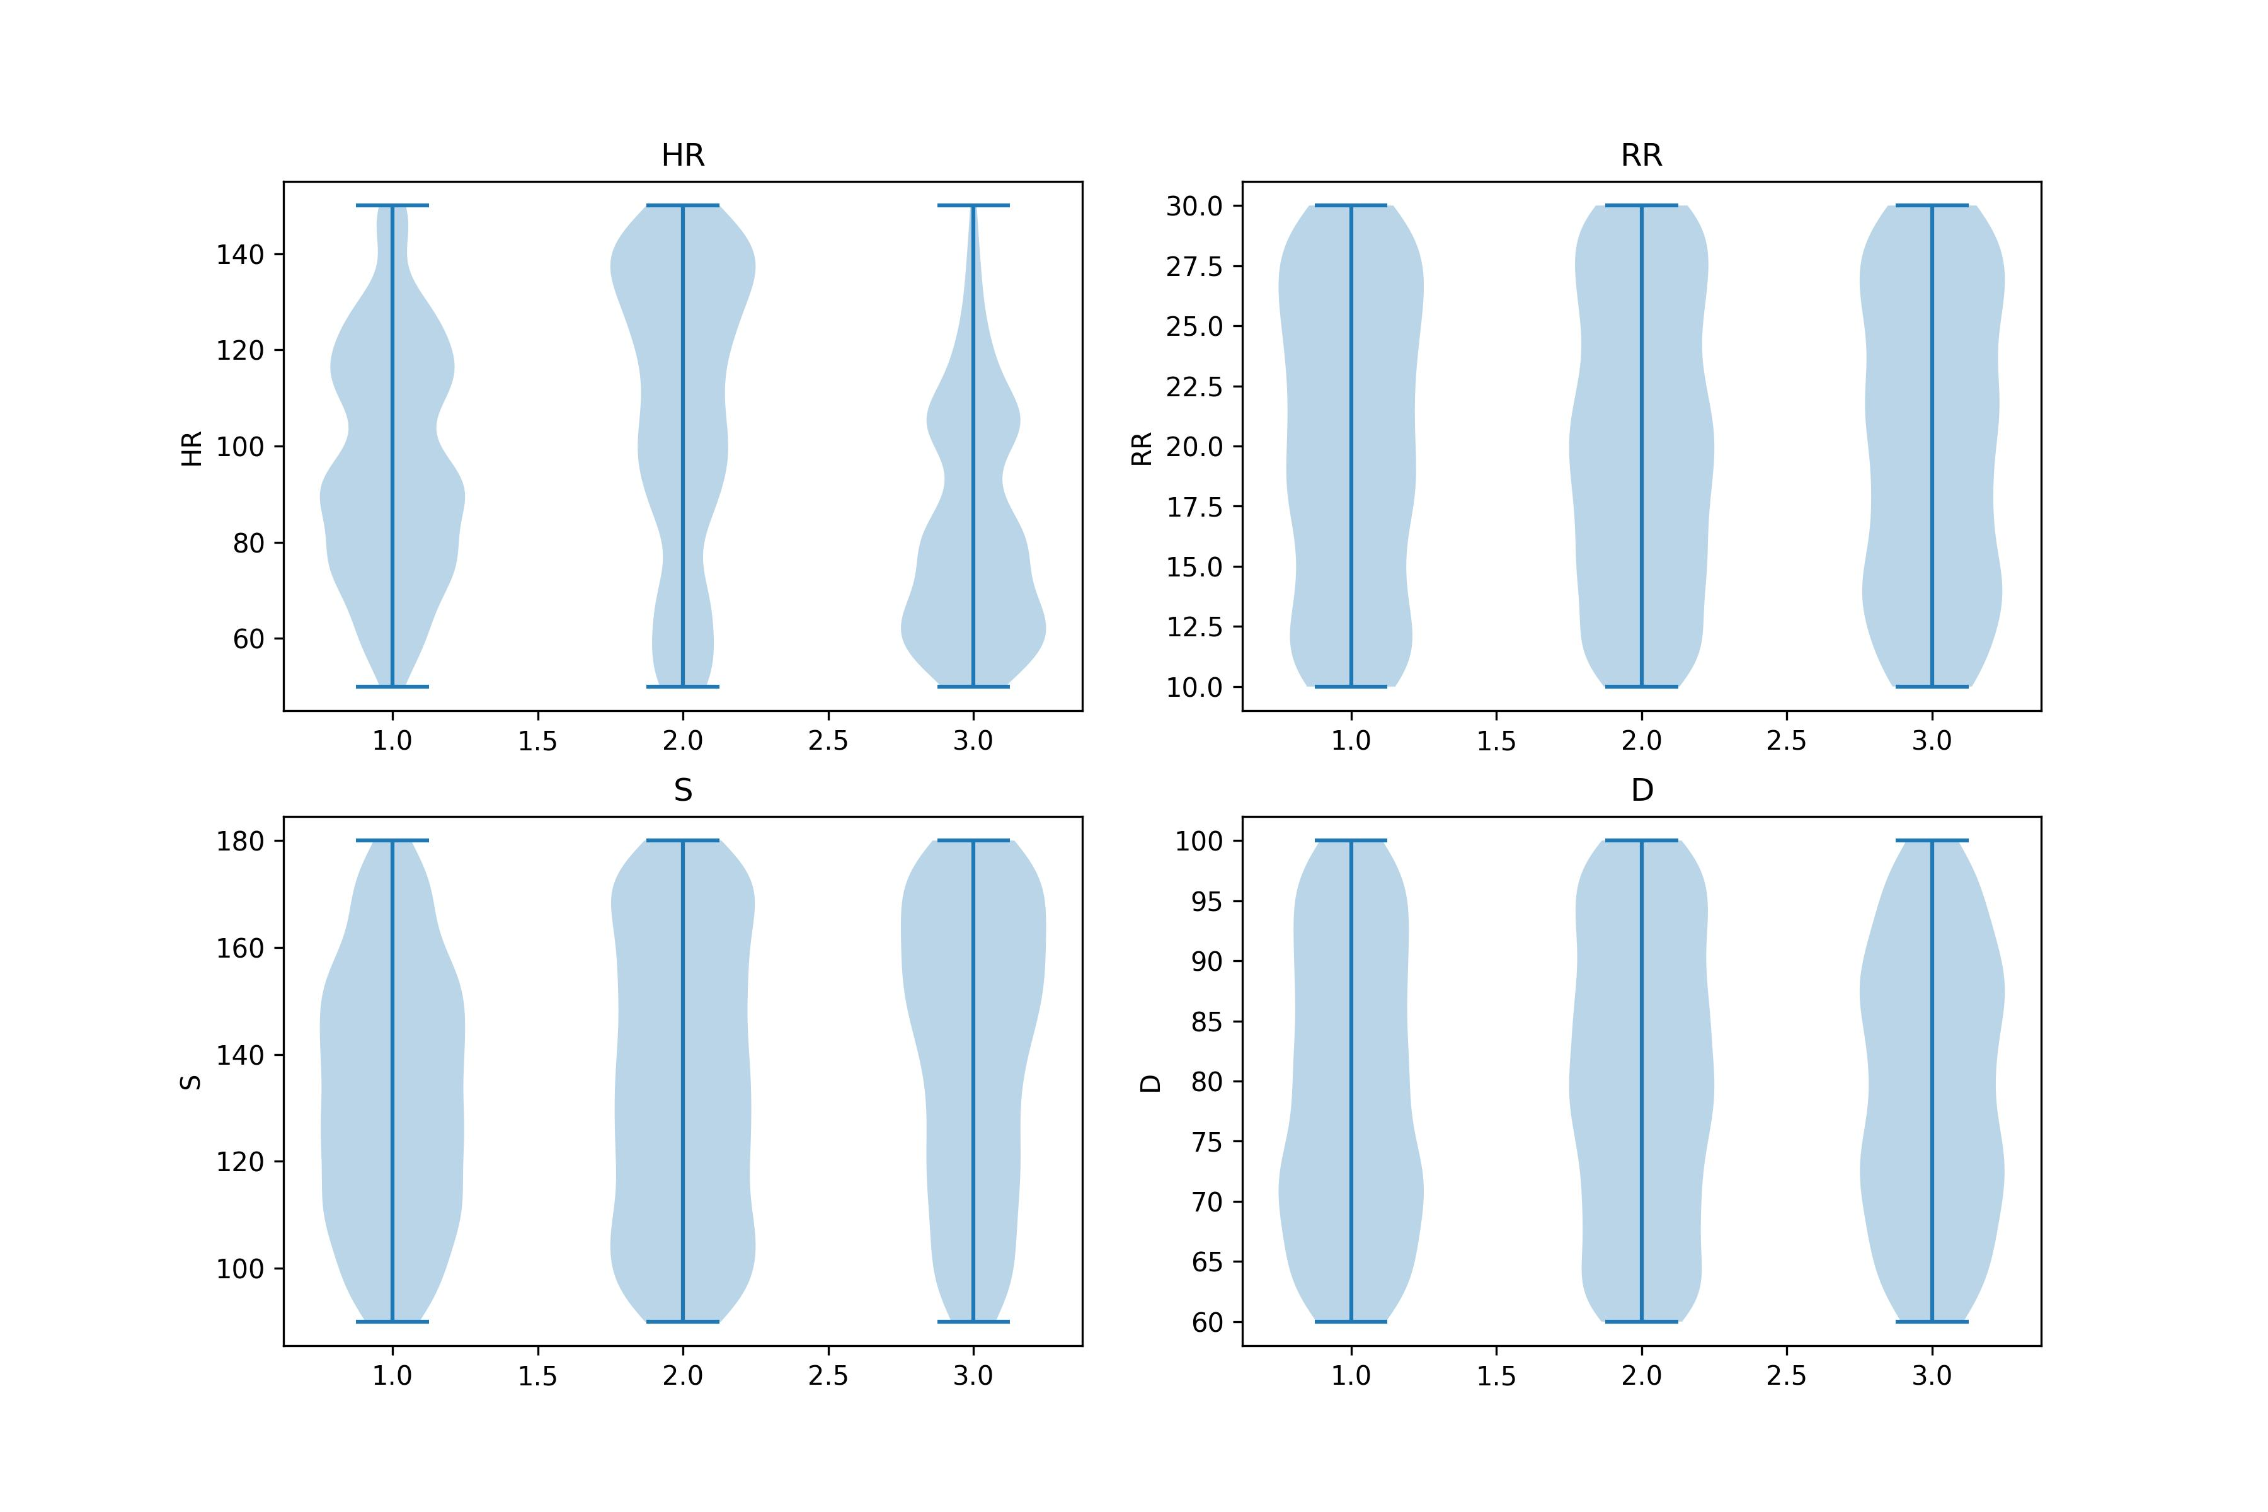
Work_4: Clustering Exploration
随后，我对之前得到的template也尝试了聚类
Conclusion1：对HR和S的聚类效果，提升不显著。对RR和D依然如此没有任何效果。
Conclusion2：K-shapes >> K-means
K-Shapes, Templates
K-Means, Templates
Notes:
2个想法：
对原始信号的片段直接聚类，他们的某些指标会不会也随之聚类。
能否通过对原始信号的片段聚类，帮助我们提升某些指标估计的精度？
所以，我对此展开了实验，得出了5个结论

Slide 17
Work_5: Tutorial
Features:
Statistical
Temporal
Spectral
Progress:
(8/8)
(11/15)
(15/20)
Now:
Input: 1-D signal (N, )
Next Step:
Input: 2-D signal (M, N)
Filter (Butter, Chebyshev, Bessel)
EMD & EEMD
Denoising(FFT & Wavelet)
Clustering(K-Means, K-shapes, H )

Slide 18
Work_6: Theoretical knowledge Learning
Signals and Systems
Application Materials
Course: EE120, Berkeley
This week's progress:
Lecture 8 (discrete-time Fourier transform)
Lecture 9 (discrete-time Fourier transform, continued)
Finish 1 lab
Next week’s plan:
Lecture 10 (the DFT; FIR filters)
Lecture 11 (Fourier transforms in two dimensions)
Finish 1 lab
This week's progress:
Statement of Purpose: 100 %
Writing Sample: 100 %
Today: Submit

Slide 19
Questions
1.我如何独自判断，一个方法是不是有效的。比如希尔伯特变化提取包络线。上次失败了，这次成功了。
1. Why laplace noise rather than gaussian noise？
1.S指标是对clustering有反应的但是有些微弱，我们是不是可以探索探索如何用聚类对S进行分类？

Slide 20
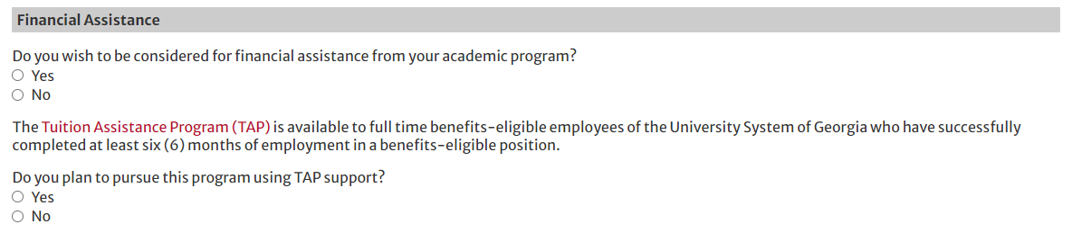
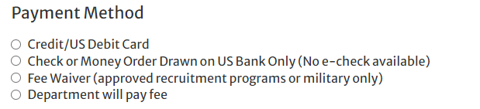
Questions About Application

Slide 21
Thanks!

